Slide 1
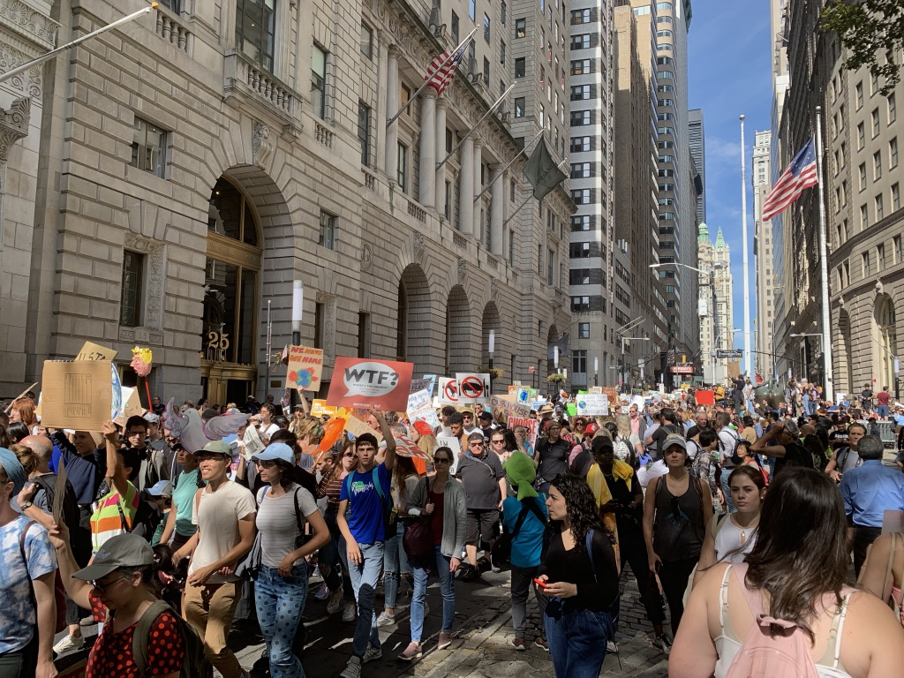
CLIMATE MARCHES

Slide 2
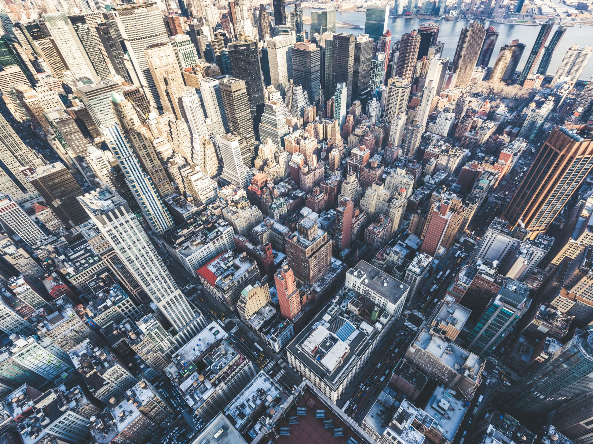
Climate March NYC
2014

Slide 3
Organized Labor

Slide 4
Front Line Communities

Slide 5
UPROSE

Slide 6
New Orleans

Slide 7
Native Americans

Slide 8
Climate Justice Alliance

Slide 9
Displaced

Slide 10
Rural Mining Communities

Slide 11
Moms

Slide 12
Food Justice Advocates

Slide 13
Anti-Nuclear Movement

Slide 14
Mainstream Environmental Groups

Slide 15
College Students

Slide 16
Code Pink

Slide 17
MBAs

Slide 18
Anti-Capitalists

Slide 19
Veterans

Slide 20
Tar Sands Opponents

Slide 21
Fracking Opponents

Slide 22
Seniors

Slide 23
Renewable Energy Advocates

Slide 24
Vegetarians

Slide 25
And a lot of others

Slide 26
Climate March 2017: DC

Slide 27
Calling Out Climate Deniers in Cabinet

Slide 28
Responding to Gutting of EPA

Slide 29
Climate Justice

Slide 30
Trumpspeak

Slide 31
Creation Care

Slide 32
Evidence Matters

Slide 33
Cross-Issue Coalitions

Slide 34
THIS

Slide 35
DAPL

Slide 36
Oil & State

Slide 37
Resistance Will Continue

Slide 38
Climate March NYC September 20, 2019

Slide 39
XR for Greta

Slide 40
Youth Led

Slide 41
Wall Street

Slide 42
Cops Protect Banks

Slide 43
Kids

Slide 44
Passing the Bullhorn

Slide 45
We Speak For The Trees

Slide 46
Greta

Slide 47
NYC March to End Fossil Fuels September 17, 2023

Slide 48
Declare a Climate Emergency

Slide 49
Decolonize to Decarbonize

Slide 50
Demilitarize

Slide 51
Families for Future

Slide 52
Green New Deal

Slide 53
The Quakers

Slide 54
The Scientists

Slide 55
Health Care Workers

Slide 56
The Communists

Slide 57
The Indigenous

Slide 58
We Act

Slide 59
Get on the bus We’re changing the world

