Slide 1
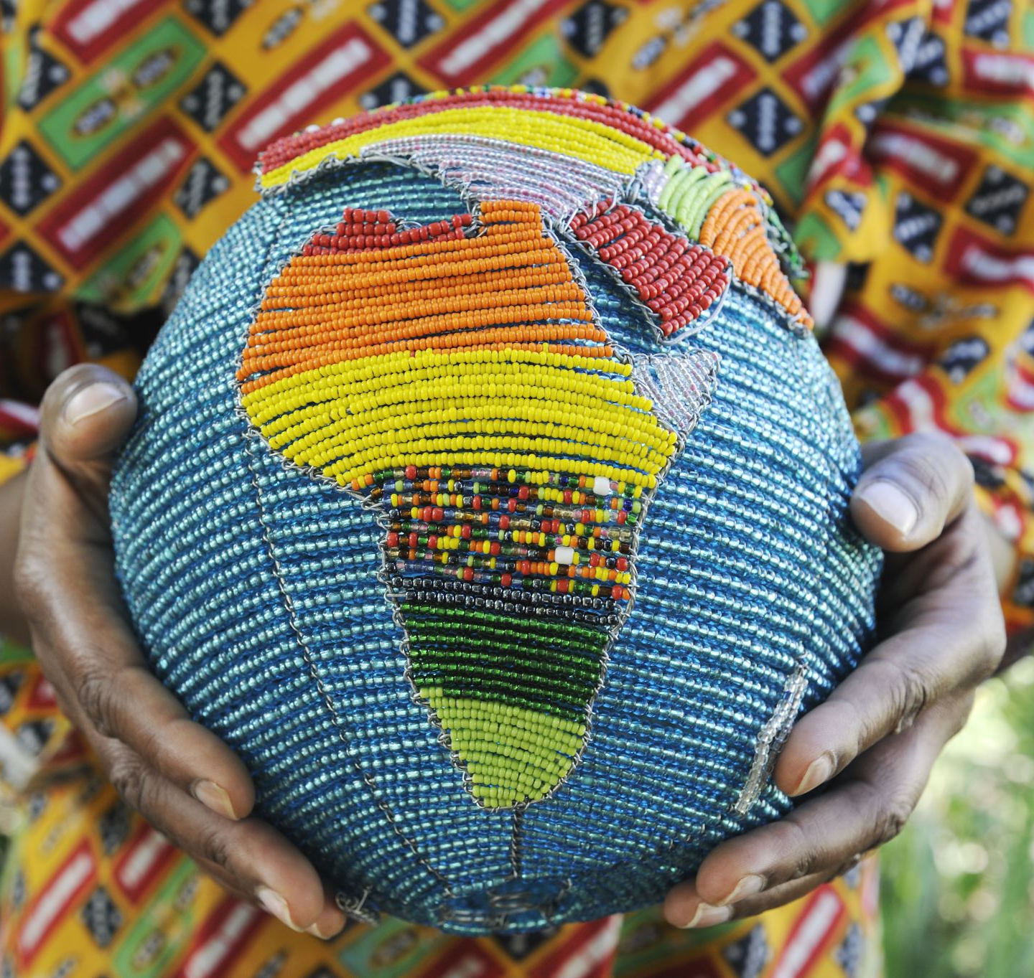
Global Climate Justice

Slide 2
Environmental Justice
Distributional
Procedural
Distributional Dimensions of:
Causes
Consequences
Policies

Slide 3
Who Contributes Most GHGs?
Wealth is the primary determinant of GHG emissions per capita
Car ownership, large homes, air travel, luxury goods, etc
Money represents carbon in an industrial growth economy
The wealthy benefit from the things that produce GHGs (investments)
The wealthy benefit from climate change (as economic opportunities)

Slide 4
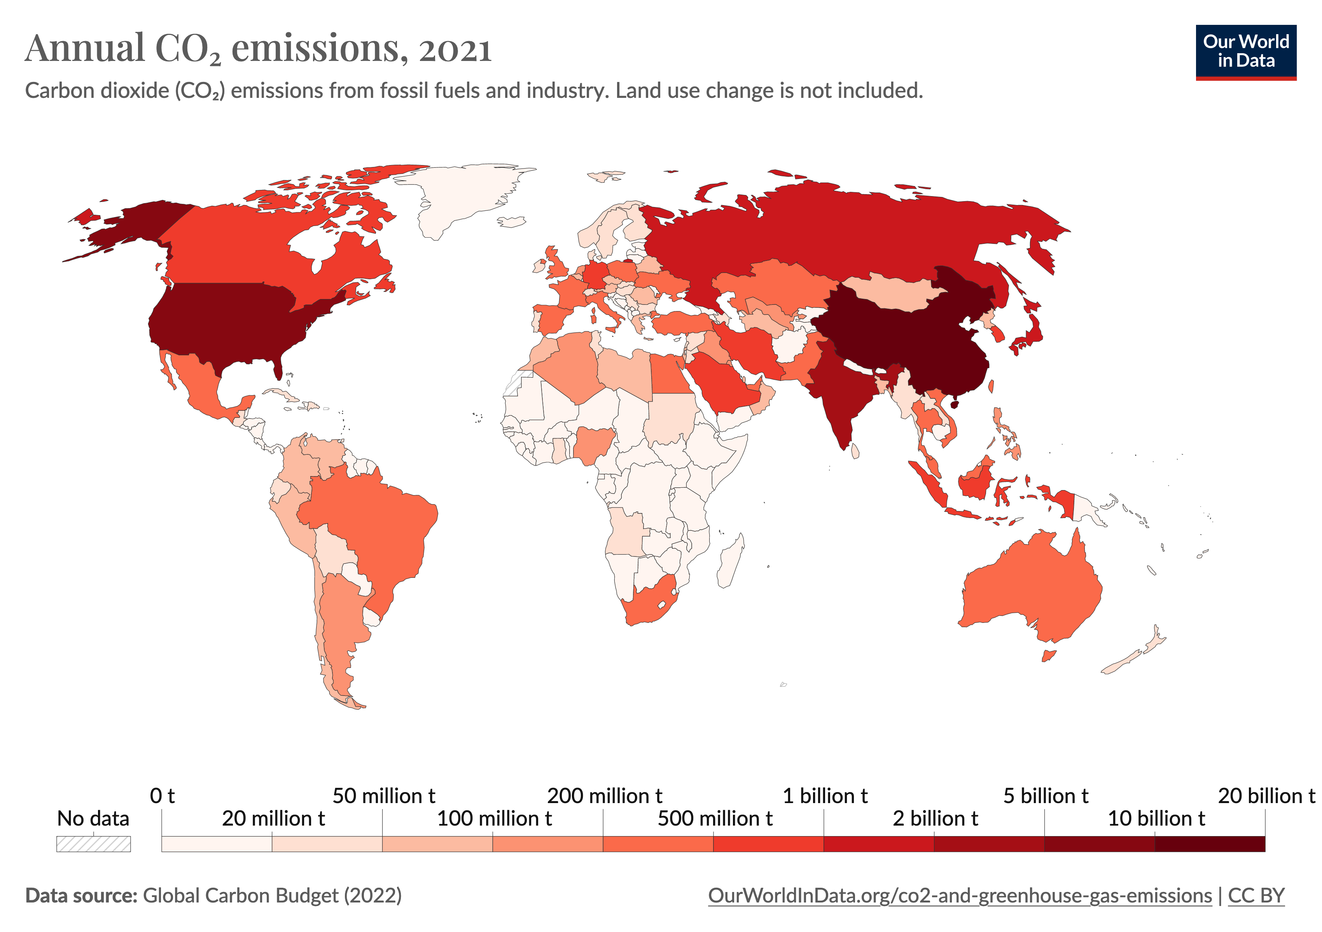
Global Environmental Inequality

Slide 5
Global Climate Injustice
Small Island Developing States (SIDs)
Total CO2 loading (“Developing” vs. “developed” countries)
Small farmers at risk
Coastal urban poor at risk
Climate migration (treatment of migrants)

Slide 6
Loss and Damage
Common but differentiated responsibility
Climate Debt / Ecological Debt

Slide 7
Right to Develop
Degrowth in the Global North
Sustainable Development in the Global South
Technology Transfer from North to South
Food justice/ sovereignty
Community based energy

Slide 8
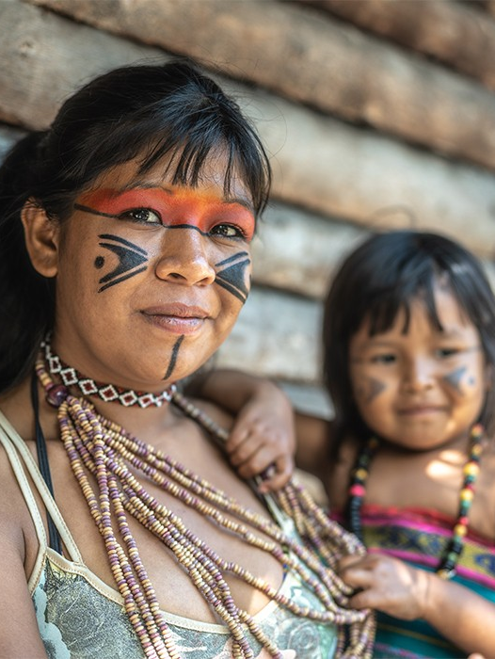
Indigenous Rights
Restorative Justice
Caring for country
Free, Prior and Informed Consent

Slide 9
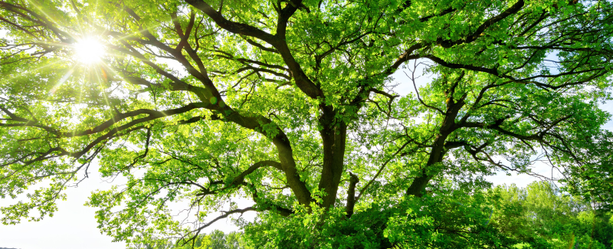
Rights of Nature
Universal Declaration of the Rights of Mother Earth
Transformative adaptation

Slide 10
Intergenerational Equity
Rights of future generations

Slide 11
Global Mobilization: Climate Change is a Social Justice Issue

Slide 12
