Slide 1
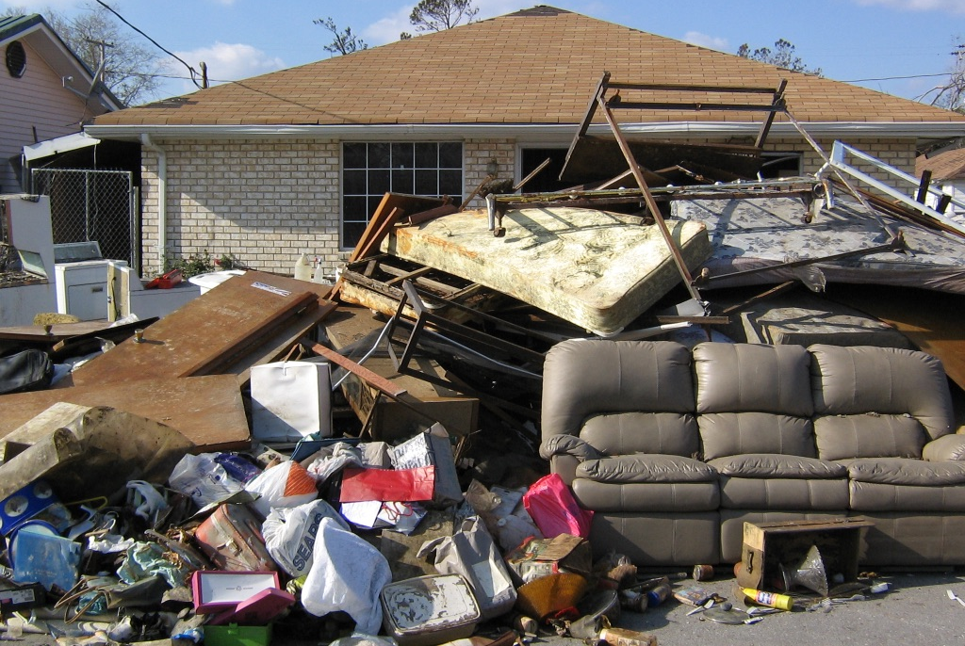
Climate Denial Networks

Slide 2
Interlocking Corporate Directorships
https://theyrule.net/

Slide 3
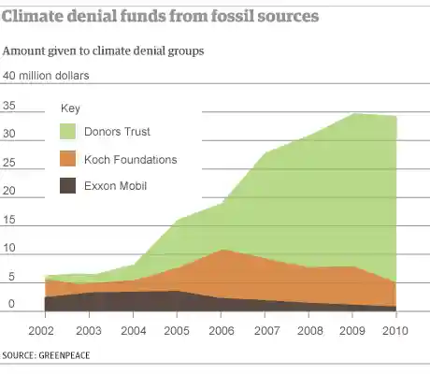
Funding for Climate Denial 2003-2010

Slide 4
Donors Trust
Donors Trust is an American nonprofit donor-advised fund. It was founded in 1999 with the goal of "safeguarding the intent of libertarian and conservative donors". As a donor advised fund, Donors Trust is not legally required to disclose the identity of its donors, and most of its donors remain anonymous.

Slide 5
Climate Misinformnation Networks

Slide 6
Climate Denial Network: 4,556 individuals. 164 conrtrarian organizations.

Slide 7
The Climate Denial Counter-Movement
Heartland Institute
Alliance for Energy and Economic Growth
New Yorkers for Affordable Energy
Chevron
British Petroleum (BP)
ExxonMobil
Greenpeace

Slide 8
Why Climate Change Denial Still Exists In The U.S.
https://youtu.be/f1rxv1yPQrc?si=2PGaTSeBn29RK-QO

